Slide 1
Preliminary results conventional rotation E26 (2018-2022) + Questions
26/9/2024

Slide 2
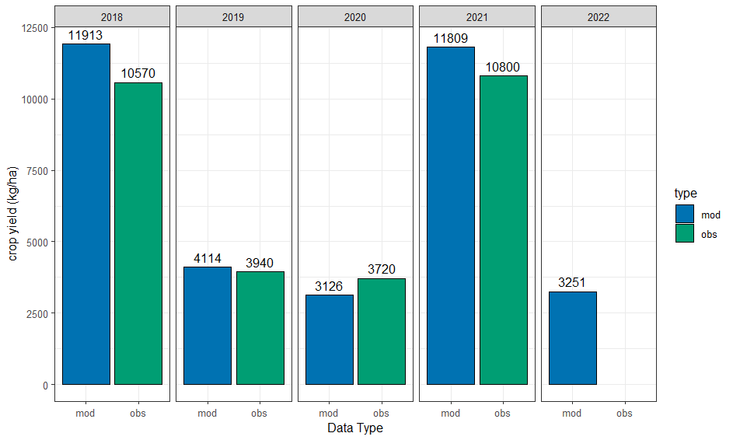
Modeled vs observed yield showed good matching, but probably has opportunities for improvement

Slide 3
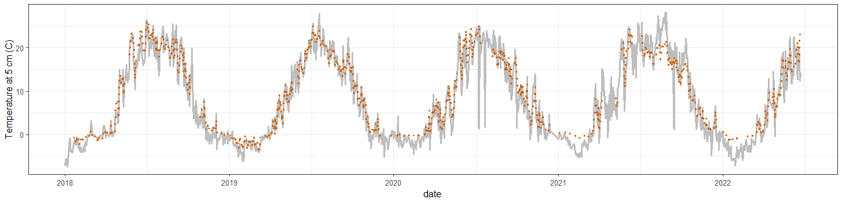
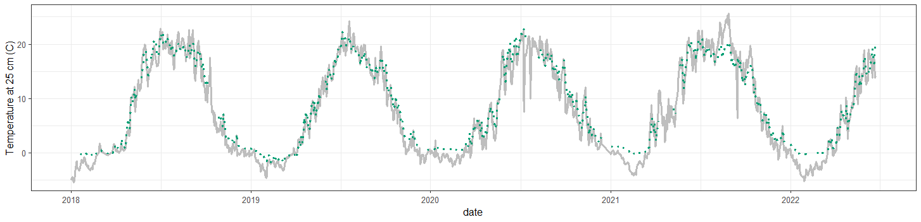
Temperature at 5 and 25 cm showed high level of agreement between observed and simulated data
Observed (color)
Simulated (gray)

Slide 4
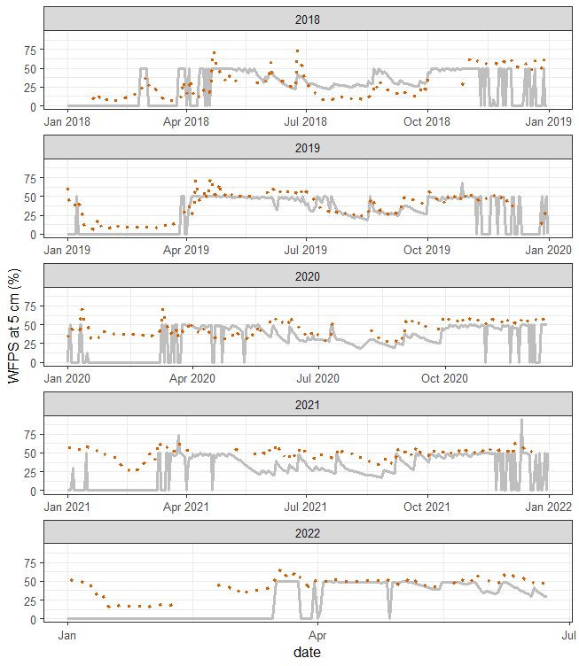
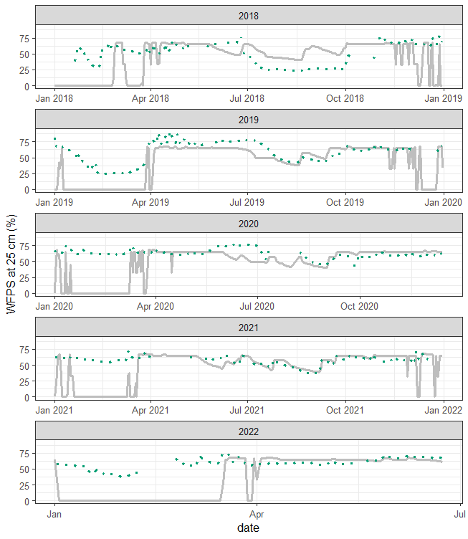
Soil moisture shows large mismatch between observed and simulated data, particularly for winter months (in this period DNDC seems to simulate 0 WFPS).
I think this is because DNDC predicts water is in the form of ice and predicts 0 WFPS then (with liquid water). Did you run into this in the past? In case yes, do you know of any model parameters that can be tunned to improve the fit?
The model seems to be doing relatively well for soil water during the cropping season

Slide 5
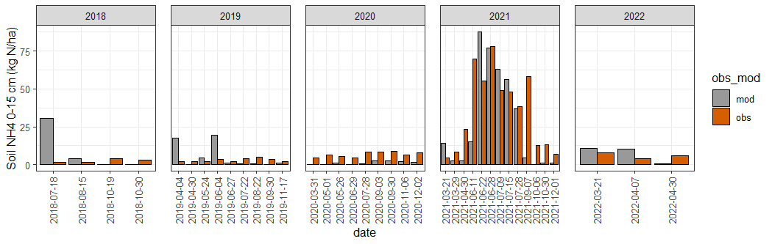
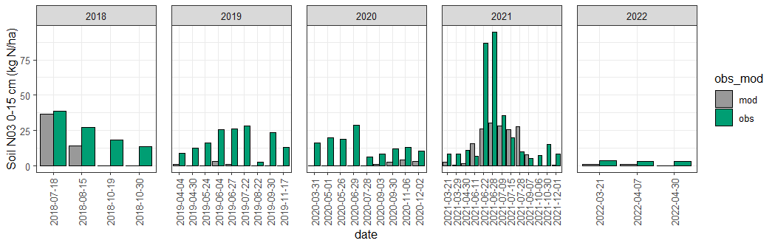
Soil nitrogen also seems to have opportunities for improvement; mismatch is potentially linked to the differences observed for soil water.
The mismatch seems to be particularly relevant in soybean years (2019-2020)
The mismatch seems to be particularly relevant in soybean years (2019-2020)
What variables could be calibrated in the model to improve soil N dynamics?

Slide 6
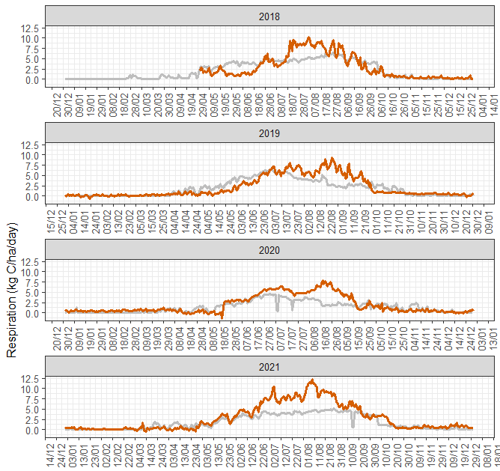
Respiration seems to show a decent fit, with error metrics matching previous published studies
Observed (color)
Simulated (gray)

Slide 7
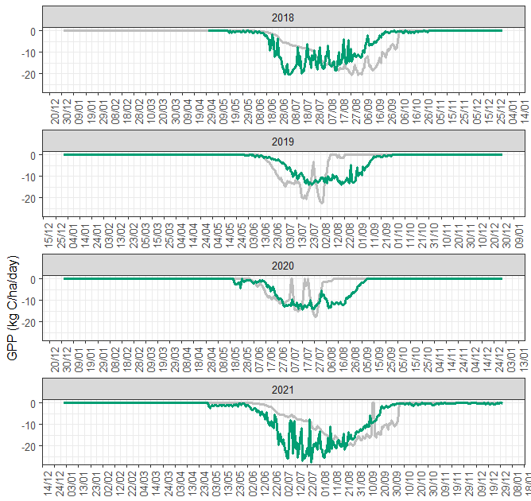
Gross primary production seems to have opportunities for fit improvement.
Observed (color)
Simulated (gray)
Model predicts GPP = 0 or very low for some summer days; is that realistic?

Slide 8
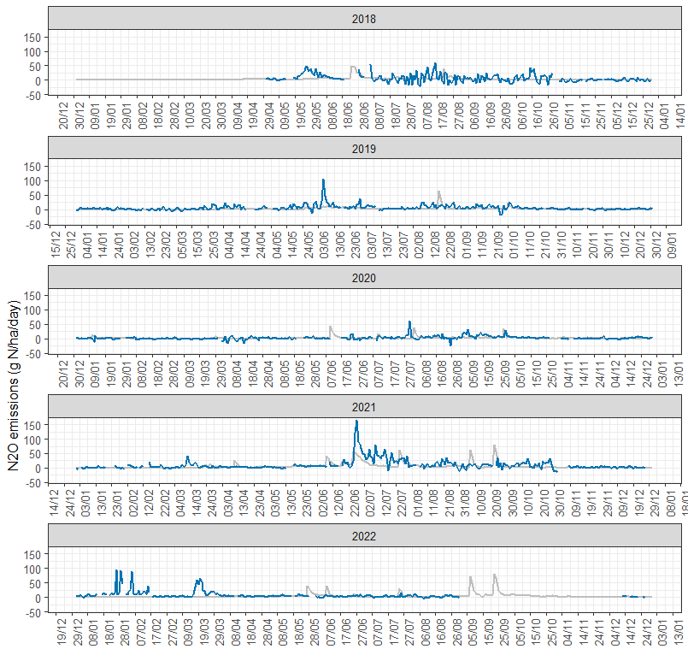
For N₂O, error metrics seem comparable to previous studies, although it may have opportunities to improve
Observed (color)
Simulated (gray)

Slide 9
Additional Questions
Nirmani and I discussed calibrating DNDC comparing simulated vs observed data with plots 1 and 3, and then validating with plots 2 and 4. However, in 2021 plot 1 has differentt management than 2, and plot 3 has different management than 4 (with and without N use inhibitors); would it still be fair to use plots for calibration and validation as outlined?
DNDC
In Azeem's files, wilting point is set up at 0.38 wfps (soil's tab); it seems to be lower in other files I have seen (0.07;0.08); is 0.38 correct?
The current porosity in the soil's tab we have on file for the field is 0.54; however, when calculating it with the following equation: bulk density listed in the mode for E26 (1.2)/particle density (2.65) = 0.45; should the porosity be set to be around 0.45?
I think Elora has tile drainage. Based on my understanding, I think that means we should be selecting "Dynamic water table <2 m" in the soils tab; is that correct? I do not think I saw it was selected in previous files.
Why is the residue left in the field set to 0.75 for corn crops in previous DNDC files? Shouldn't it be 1? (crops tab)
Should we be using the CO2 increase rate option in the model? (Climate tab)
When fertilizer is incorporated through disking, should we use "surface" application with an 15 cm depth, or the injection option?
How does the calibration process exactly work? What I have been trying is to play with some key variables one at a time in the model (varying the values +-20%), and then check what was the impact on RMSE(%) for the variables of interest (N2O fluxes, CO2 fluxes, GPP, yield, and soil water). I am not sure how I should exactly proceed with this information: should I re-set parameter values to the ones showing the lowest error values all at once after running scenarios, or should I follow more of a sequential change of parameters where I test values +-20% for one parameter, choose the best option and then continuing with the next parameter, and so on?
For calibration, I chose to test calibrating all corn years in the rotation together, and then all soybean years together. This would result in a single set of parameters for each crop for all the modeling exercise. Does that sound correct?

Slide 10
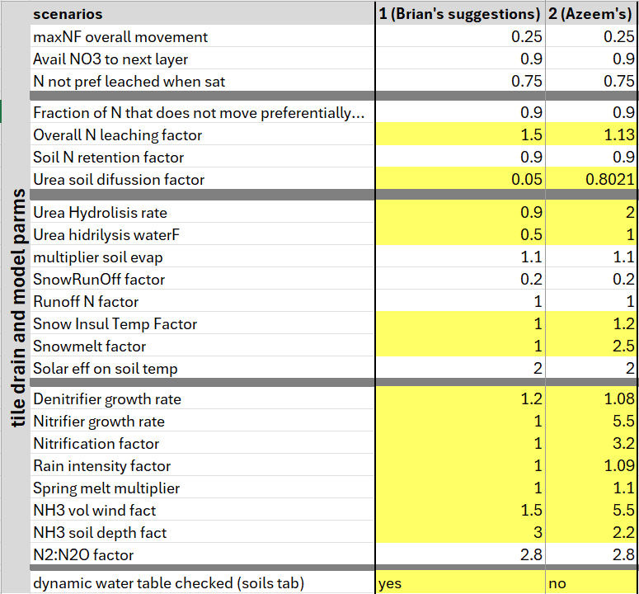
Questions
DNDC
I noticed that some of the values in the “tile drain and model parms” differ between the file that Azeem shared (modeling for 2015-2017), compared to those suggested by Brian in a document that he shared with Nirmani some time ago (see table, and colored values). I imagine some of that is due to calibration, but I was curious how you got those values.

